Slide 1
Export Controls Compliance

Slide 2
Export control regulations and their application

Slide 3
EXPORT CONTROL REGULATIONS
The U.S. government regulates the transfer of information, commodities, technology, and software that are strategically important to U.S. interests of national security, economic and/or foreign policy concerns.
Military Items
Department of State, International Traffic in Arms Regulations (ITAR)
Directorate of Defense Trade Controls United States Munitions List (USML)
Dual Use Items
Department of Commerce, Export Administration Regulations (EAR)
Bureau of Industry & Security Commerce Control List (CCL)
Travel
Department of the Treasury, Foreign Assets Control Regulations (FACR) and Office of Foreign Assets Control other various regulations

Slide 4
What is the intent of the export control laws?
Restrict exports of goods and technology that could contribute to the military potential of adversaries
Prevent proliferation of weapons of mass destruction (nuclear, biological, chemical)
Prevent terrorism
Comply with U.S. trade agreements and trade sanctions against other nations

Slide 5
What constitutes an Export?
An export occurs whenever an item, commodity, technology, or software is sent out of the U.S. to a foreign destination.
If the item being released or exported is a “controlled item” then an Export License may be required before the transfer can legally occur
Examples of activities that are considered exports:
Shipping or hand carrying items outside of the U.S.
Written/oral communications and electronic/digital transmissions
Providing visual inspections or tours of facilities
Use or application of a controlled service or technology on behalf of or for the benefit of a foreign person or entity

Slide 6
Deemed Exports
In addition to the physical transfer of items out of the country, the U.S. Government also actively regulates the release or transmission of controlled technology or information to foreign persons within the U.S (e.g., a foreign national graduate student at SIU). This is a “deemed export.”
A “foreign person” is:
Any foreign government
Any foreign corporation or organization that is not incorporated or organized to do business in the U.S.
Any individual who is not a U.S. citizen or lawful permanent resident of the U.S. (green card holder)
Deemed Exports are regulated by the same Export Controls as the actual transfer of items out of the U.S.

Slide 7
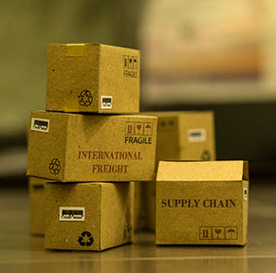
When Export controls may apply
Export Controls may apply to the following activities. In general, restrictions apply to information, items, technologies or services that include:
Military or “dual use” items
Chemical/biologics weapons
Encryption technology & related software
Funding, information, services or items provided to embargoed countries

Slide 8
When Export Controls May apply
It is critical to note that many normal, everyday University activities are subject to Export Controls, including:
Traveling overseas on University business (e.g., conferences, conducting field work, international symposia)
Research collaborations with foreign nationals (here or abroad)
Sponsoring research (e.g., via a subcontract) to an embargoed or sanctioned country
Export Controls do not only apply to military work, they touch research in a variety of ways.

Slide 9
EAR Controlled: Commerce control list (CCL)
Commerce Control List Categories
Category 0 – Nuclear and Miscellaneous
Category 1 – Materials, Chemicals, Microorganisms, and Toxins
Category 2 – Materials Processing
Category 3 – Electronics
Category 4 – Computers
Category 5 – Part 1: Telecommunications
Part 2: Information Security
Category 6 – Sensors and Lasers
Category 7 – Navigation and Avionics
Category 8 – Marine
Category 9 – Aerospace and Propulsion
Five Product Groups
Product Group A – Systems, Equipment, and Components
Product Group B – Test, Inspection, and Production Equipment
Product Group C – Material
Product Group D – Software
Product Group E – Technology
Export Control Classification Number
E.g. 5A992.c
Describes item and indicates control
Items under Commerce jurisdiction but not on CCL are EAR99

Slide 10
EAR: Examples of dual-use items
Use of Concern
Legitimate Use
Gas centrifuge,
Fabrication of WMD
Machine Tools
Machine Parts and Components
Carbon Fibers
Missile Components
Golf club shafts, Fishing rods
Thiodiglycol
Mustard Gas
Plastics, Dyes, Inks
Stabilize biological agents for biological weapons
Freeze-Drying Equipment
Instant Coffee

Slide 11
ITAR: U.S. Munitions List (USML)
I
II
III
IV
V
VI
VII
VIII
IX
X
XI
XII
XIII
XIV
XV
XVI
XVII
XVIII
XIX
XX
XXI
Firearms and Related Articles
Guns and Armament
Ammunition/Ordnance
Launch Vehicles, Guided Missiles, Ballistic Missiles, Rockets, Torpedoes, Bombs, and Mines
Explosives and Energetic Materials, Propellants, Incendiary Agents, and Their Constituents
Surface Vessels of War and Special Naval Equipment
Ground Vehicles
Aircraft and Related Articles
Military Training Equipment and Training
Personal Protective Equipment
Military Electronics
Fire Control, Laser, Imaging, and Guidance Equipment
Materials and Miscellaneous Articles
Toxicological Agents, Including Chemical Agents, Biological Agents, and Associated Equipment
Spacecraft and Related Articles
Nuclear Weapons Related Articles
Classified Articles, Technical Data, and Defense Services Not Otherwise Enumerated
Directed Energy Weapons
Gas Turbine Engines and Associated Equipment
Submersible Vessels and Related Articles
Articles, Technical Data, and Defense Services Not Otherwise Enumerated

Slide 12
Areas of concern

Slide 13
What You Need to Look For . . .
Foreign travel
Foreign research partners
Foreign visitors to campus
Foreign students/faculty
Shipping or receiving from foreign countries
Military equipment used in your research (thermal cameras/night vision goggles)
If you are developing something new

Slide 14
drones
Unmanned Aerial Vehicles (UAV) and Unmanned Aircraft Systems (UAS), commonly referred to as “drones”, are increasingly popular tools in research.
Many drones are export controlled.
As part of the drone registration process, the Export Controls Office will determine if the drone is export controlled.
If the drone is export controlled, the Export Controls Office will coordinate with the responsible party to create a Technology Control Plan.
Discuss with the Export Controls Office if you intend to design, build, research, use in research, modify, dismantle, and/or operate a drone in foreign countries and/or with foreign nationals in the U.S.

Slide 15
International visitors
ALL international visitors to campus should be screened and cleared prior to their visit.
Some international visitors, such as visiting scholars, go through a formal process, in which restricted party screening is performed.
When planning for international visitors that are not going through a formal process, contact the Center for International Education to coordinate the visit so that the individuals can be screened.

Slide 16
Restricted universities
CHINA
BEIJING UNIVERSITY OF AERONAUTICS AND ASTRONAUTICS (BUAA)
BEIJING UNIVERSITY OF POSTS AND TELECOMMUNICATIONS (BUPT)
GUANGDONG UNIVERSITY OF TECHNOLOGY
HARBIN ENGINEERING UNIVERSITY
HUNAN UNIVERSITY STATE KEY LAB OF CHEMO/BIOSENSING & CHEMOMETRICS
NANCHANG UNIVERSITY
NANJING UNIVERSITY OF SCIENCE AND TECHNOLOGY
NANJING UNIVERSITY OF AERONAUTICS AND ASTRONAUTICS
NATIONAL UNIVERSITY OF DEFENSE TECHNOLOGY (NUDT)
NORTHWESTERN POLYTECHNICAL UNIVERSITY
SICHUAN UNIVERSITY
SOUTHERN UNIVERSITY OF SCIENCE AND TECHNOLOGY DEPARTMENT OF MECHANICAL AND ENERGY ENGINEERING
SUN YAT-SEN UNIVERSITY
TIANJIN UNIVERSITY
UNIVERSITY OF ELECTRONIC SCIENCE AND TECHNOLOGY OF CHINA
IRAN
AL-MUSTAFA INTERNATIONAL UNIVERSITY
BAQIYATTALLAH UNIVERSITY OF MEDICAL SCIENCES
IMAM HOSSEIN UNIVERSITY
MALEK ASHTAR UNIVERSITY
SHAHID BEHESHTI UNIVERSITY
SHARIF UNIVERSITY OF TECHNOLOGY
UNIVERSITY OF IMAM HOSEYN
UNITED STATES
US TECH UNIVERSITY, INC
WORCESTER UNIVERSITY PHARMACY

Slide 17
Countries of particular concern
China Russia
Iran North Korea
Cuba Syria
Belarus Ukraine (crimea region)
Sudan Venezuela
Cambodia

Slide 18
All SIU System employees, SIUE faculty and staff, SIUC faculty and staff, SIU School of Medicine faculty and staff that travel to the designated foreign countries. All SIU travel to the below countries WILL REQUIRE that an Informational Technology Services clean laptop be used during SIU business travel to those countries.
SIU Clean Laptop Program
Your SIU issued laptop computer SHALL NOT be transported to any of the below countries.
IRAN SYRIA SUDAN NORTH KOREA CUBA BELARUS CHINA RUSSIA
CAMBODIA VENEZUELA UKRAINE (Crimea Region)

Slide 19
International TRAVEL TIPS for high-risk countries
Prior to Travel:
Change all passwords
Leave unneeded items such as keys, cards, badges and fobs at home
Remove financial information
Document account numbers to anything you do take
Obtain an RF-shielded cover or case for any RFID cards.

Slide 20
International TRAVEL TIPS for high-risk countries
During Travel:
Never use shared computers
Logout and shut down devices when not in use
Keep devices with you at all times
Don’t send sensitive messages
Disable and fully cover integrated laptop cameras
Physically disconnect any integrated laptop microphones
Don’t plug your devices into charger kiosks
Don’t use or borrow others’ USB memory sticks

Slide 21
International TRAVEL TIPS for high-risk countries
After Travel:
Immediately discontinue use of the travel laptop
Change all passwords
Don’t plug in any USB memory sticks that you received during travel
See full details of International Travel Tips at https://siusystem.edu/academic-affairs/export-controls/InternationalTravelTips.pdf

Slide 22
What is being Targeted?
Biotechnology and pharmaceuticals
Nanotechnology
Quantum computing
Advanced materials
Submersible vehicles
Acoustic communications and sensors
Communications and encryption technology
Satellites, spacecraft and related items
Weapons systems yet unclassified

Slide 23
Methods Used to Target Technology
Hacking/computer intrusions
Unsolicited e-mail/telephone requests
Compromise of laptop/phone while traveling overseas
Surveillance of U.S. travelers while abroad
Visits by scientific, research, & governmental delegations
Attending/hosting conferences/trade shows
Relocating R&D facilities overseas
Downloading information from your network
National laboratories
Liaison with universities that have ties to defense contractors
Front companies

Slide 24
Evolving Threats and Tradecraft
Incentives to relocate R&D facilities overseas
Joint ventures involving foreign entities
Liaisons with universities that have ties to defense contractors
Offers to provide marketing services in order to gain access/entry
Recruitment by foreign intelligence services in various guises
Red Flags/Know Your Customer: Illegitimate companies, insufficient customer knowledge of technology, multiple intermediate parties

Slide 25
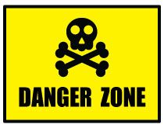
Words/Phrases to Look for in Research
“ITAR” or “ear”
“Export Control Regulations Will Apply to the Research”
Publication Restrictions
Restrictions/Prohibitions Against Participation of Research Personnel Based on Citizenship/National Origin.
Military Equipment
“USML”
“CCL”
Export Control Clause

Slide 26
Export control exclusions

Slide 27
Export Controls & University Research
The good news: The vast majority of research conducted at U.S. universities is exempt from export controls under three exclusions provided for under the current regulations:
The Fundamental Research Exclusion
The Educational Information Exclusion
The Public Information Exclusion

Slide 28
The Fundamental Research Exclusion
The Fundamental Research Exclusion applies to any basic or applied research in science or engineering where the resulting information is ordinarily published and broadly shared in the scientific community
It is important to note that the fundamental research exclusion only covers the “results” of research. It does not cover actual materials, items or technologies involved in or resulting from the research. Export Controls may still apply to these items.

Slide 29
The Fundamental Research Exclusion
For research to qualify as Fundamental Research, all of the following must be true:
There can be no restrictions on publication
There can be no access or dissemination restrictions
The research must take place at an accredited institution in the U.S.
Delays in finalizing sponsored research agreements can be encountered when sponsors try to insert publication or access restrictions in agreements which would nullify the Fundamental Research Exclusion.

Slide 30
Application to university research

Slide 31
When Export Controls may apply to your research
The following list of questions is designed to help you determine if Export Controls may apply to your research:
Does the research involve military, weapons, defense, chemical or biological weapons, encryption technology & software, space or other dual-use items or export restricted technologies?
Does the research involve collaboration with foreign colleagues (including graduate students) either here at SIU/SIUE or abroad?
Does the research involve the transfer or shipment of equipment, materials or funding out of the U.S.?

Slide 32
When Export Controls may apply to your research (continued)
Does any part of the research take place outside of the U.S. (e.g. field work)?
Does any part of the research involve the receipt or use of Export Controlled information or items provided by a 3rd party?
Are there any contractual restrictions on publication or access to or dissemination of the research results?

Slide 33
When Export Controls may apply to your research (continued)
Does the research involve the shipment or transfer of materials, money or any other type of collaboration with foreign nationals from a sanctioned or embargoed country (i.e. Cuba, Iran, North Korea, Sudan, or Syria)?
Do you have any reason to believe that the end-user or the intended end-use of the item or information violates any existing export controls?

Slide 34
When Export Controls may apply to your research (continued)
If you answered yes to any of the proceeding questions, then the research may be subject to Export Controls an assessment will need to be done.
Contact the Export Controls
office for more information.

Slide 35
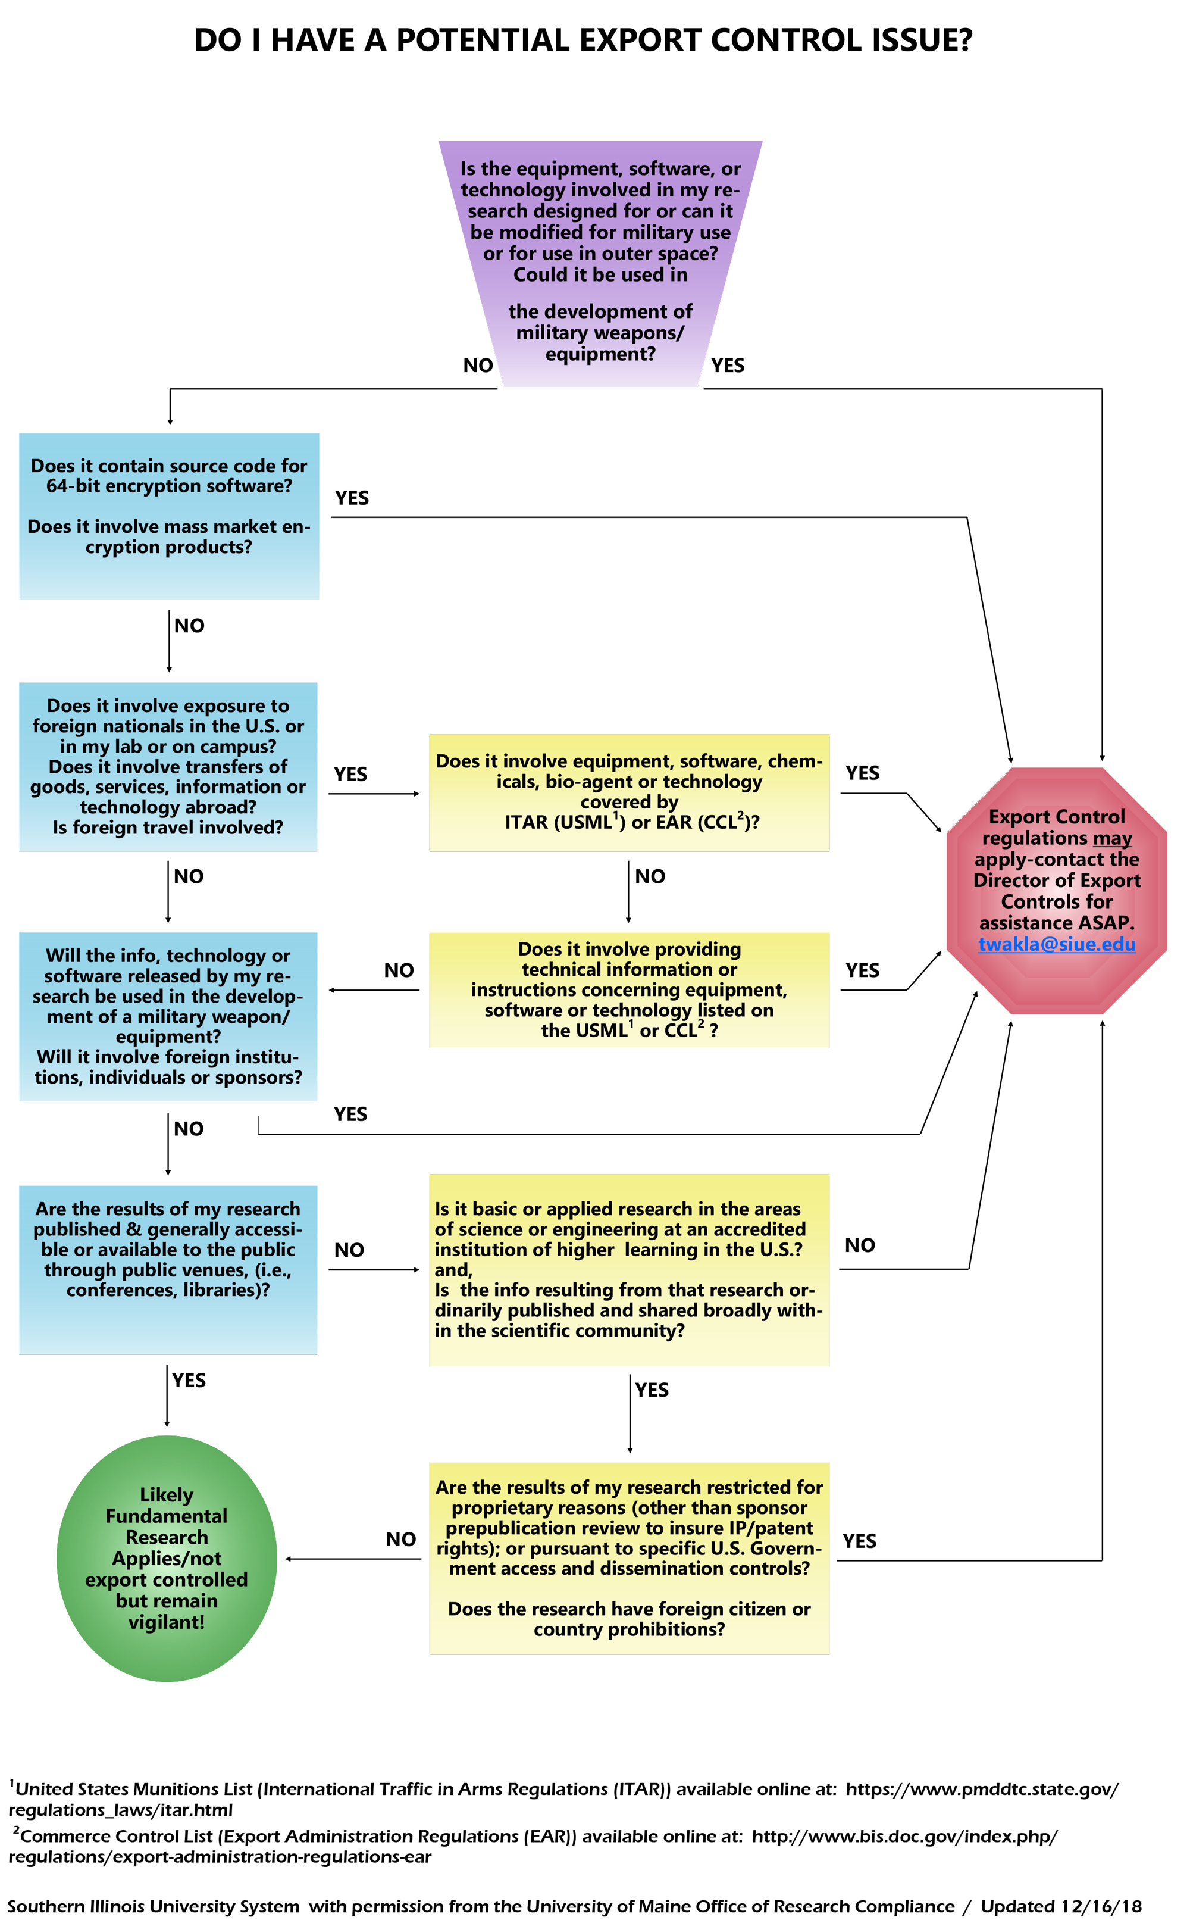
Export control decision tree
Located on the Export Controls website:
https://siusystem.edu/academic-affairs/export-controls/decision-tree.shtml

Slide 36
Scenario 1
Dr. Chen in microbiology responds to a department of defense (dod) program announcement for bioterrorism research.
The Broad Agency Announcement (BAA) requires that all foreign nationals are named and that their country of citizenship and country of origin be provided.
As of the time of the proposal there are no foreign nationals named as being on the project. The sponsored projects office submits the proposal.
The resulting contract states that no foreign nationals may work on the project without the express written consent of the contracting officer.
Notes:
TW

Slide 37
Is it Fundamental Research?
Scenario 1: Discussion
Questions to Ask:
Is there an intent to publish? YES
Are there any publication restrictions? MAYBE
Are there any foreign national restrictions? MAYBE
Are there any access or dissemination restrictions on results for national security purposes? MAYBE
Need to Know:
Is the clause for national security purposes or is it there so that foreign nationals can be identified and screened by the governmental agency?
Notes:
TW

Slide 38
Is it Fundamental Research?
Scenario 1: Discussion Continued
Consider along with the prior approval of foreign nationals:
Are there also publication restrictions?
Does the government claim rights to the data from the research?
What does the scope of work say?
If the restrictions exist for national security purposes - then NO, it is not Fundamental Research
Notes:
TW

Slide 39
Scenario 2
Dr. Smith purchased an infrared
camera for use in his research projects.
The Export Clause in the Purchase Order stated:
This order is subject to U.S. export and import control laws and regulations. Any item or technical information pertaining to this order shall not be provided to or accessed by a non-U.S. person, entity, foreign country or any Denied Party without the prior written authorization from FLIR Camera Inc and, where applicable, the relevant U.S. Government Agency. The parties will comply with the aforementioned regulations and shall reasonably cooperate to support controlled activities pursuant to such regulations.
Notes:
TW

Slide 40
Manufacturer Classification
Scenario 2: Discussion
If it is a commercially available item, it is important to request the classification from the manufacturer as the classification varies by model.
FLIR Cameras
USML Cat. XII(c) 640x480 - 25Hz/30Hz (Greater than 9Hz) cameras
6A003.b.4.b FULL FRAME RATE LWIR Thermal Video Cameras 30HZ/60HZ (Fast Video)
6A993 SLOW FRAME RATE LWIR Thermal Video Cameras Less than 9Hz
Visit: https://www.flircameras.com/export_conditions
Notes:
TW
Note: There are several countries to which the export of thermal imaging cameras is prohibited under any circumstances, regardless of the camera resolution or video rate.
These terrorist supporting countries are: Cuba, Iran, Libya, North Korea, Sudan, and Syria. Export policies governing the export of thermal imaging cameras are established by the U.S. government, and in order for RHP International to comply with the policy requirements, we in turn ensure that our customers agree to these conditions.

Slide 41
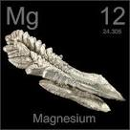
Scenario 3
Dr. Jones in Chemistry wants to manipulate
some magnesium for a study that he is
conducting.
Dr. Jones buys pure magnesium from China and then modifies the pure magnesium to create pure magnesium crystal.
Dr. Jones wants to know is the magnesium crystal controlled?
Notes:
TW

Slide 42
Classification
Scenario 3: Discussion
1C228 Magnesium having both the following characteristics
Items: a. Containing less than 200 parts per million by weight of metallic impurities other than calcium; and b. Containing less than 10 parts per million by weight of boron.
Notes:
TW

Slide 43
Violations and penalties

Slide 44
Penalties for Noncompliance
ITAR
Criminal: up to $1M per violation and up to 10 years in prison
Civil: seizure and forfeiture of articles, revocation of exporting privileges, fines of up to $500K per violation
EAR
Criminal: $50K-$1M or five times value of export, whichever is greater, per violation, up to 10 years in prison
Civil: loss of export privileges, fines $10K-$120K per violation
OFAC
Criminal: Up to $1M and 10 years in jail
Civil: $12,000-$55,000 per instance
Loss of Export Privileges/Federal Research Funding

Slide 45
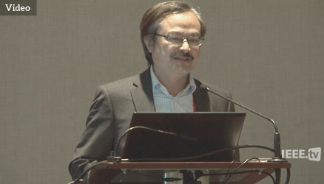
Ucla adjunct professor sentenced
Professor Yi-Chi Shih
Adjunct Professor at the University of California, Los Angeles (UCLA)
Conspired to export sensitive semiconductor chips with military applications to China
July 2021: Sentenced to 63 months in federal prison and ordered to pay $362,698 in restitution to the IRS and was fined $300,000
Guilty of mail fraud, wire fraud, subscribing to a false tax return, making false statements to a government agency and conspiracy to gain unauthorized access to a protected computer to obtain information

Slide 46
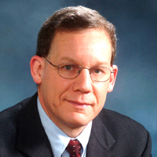
Harvard professor indicted
Dr. Charles Lieber
January 2020: Former Chair of Harvard University’s Chemistry and Chemical Biology Department and two Chinese nationals were charged in connection with aiding the People’s Republic of China.
June 2020: Dr. Lieber indicted by a federal grand jury on two counts of making false statements.
Unbeknownst to Harvard University, beginning in 2011, Lieber became a “Strategic Scientist” at Wuhan University of Technology (WUT) in China and was a contractual participant in China’s Thousand Talents Plan from about 2012 to 2017.
Alleged that Lieber lied about his involvement in the Thousand Talents Plan and affiliation with WUT.
The charge of making false, fictitious and fraudulent statements provides for a sentence of up to five years in prison, three years of supervised release and a fine of $250,000.

Slide 47
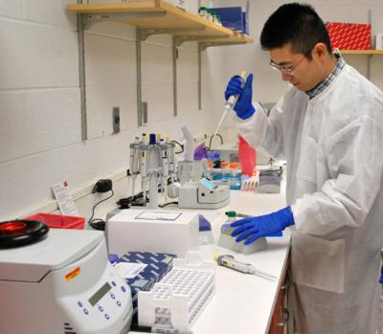
Iowa state graduate student sentenced
Wentong Cai and Bo Cai
April 2015: Wentong Cai, a graduate student at Iowa State University, sentenced to 18 months in federal prison, while his cousin, Bo Cai was sentenced to 24 months in prison.
Pleaded guilty for conspiring with each other to illegally export sensors from the U.S. to China without first obtaining the required export license in violation of the Arms Export Control Act and the International Traffic in Arms Regulations (ITAR).
In the U.S. on a student visa, Wentong acquired the sensors under the ruse that he planned to use the sensors at Iowa State University where he was a graduate microbiology student. Wentong used his ISU email while contacting an undercover agent. He attempted to obtain 20 of the ARS-14 sensors from a New Mexico based manufacturing company.
Wentong and Bo did this despite knowing that the sensors could not be exported without a license and that the U.S. did not issue such licenses to export these sensors to China.

Slide 48
Roles and responsibilities

Slide 49
How do you help ensure the University is compliant with Export Controls?
Review your research for potential export control issues and if you think that your work may be subject to Export Controls, contact the Export Controls office as early as possible (obtaining a license can take 3 to 6 months).
If you are planning to receive or use export-controlled information or technology from outside the University contact the Export Controls office.
If you are planning to hire a foreign national or will be working with foreign collaborators on export-controlled research, you must determine if an Export License is required. If required, the License must be obtained—Before work can proceed. Contact the Export Controls office for assistance in obtaining the appropriate licenses.

Slide 50
Summary
Export Controls apply to all international University activities not just to shipping equipment overseas.
If your research includes international activities an export control assessment will need to be done to determine if an export license(s) are needed.
Assistance is readily available to help you determine your export control compliance requirements.

Slide 51
Contact Information
SIUE
Todd Wakeland
Director of Export Controls
3311 Rendleman Hall
Box 1259
Edwardsville, IL 62026
twakela@siue.edu
618-650-2476
SIUC
Brenda Martin
Export Control Officer
363 Woody Hall
Mail Code 4344
Carbondale, IL 62901
bjmartin@siu.edu
618-453-2308
exportcontrols@siu.edu
Export Controls Website
https://siusystem.edu/academic-affairs/export-controls/index.shtml

