Slide 1
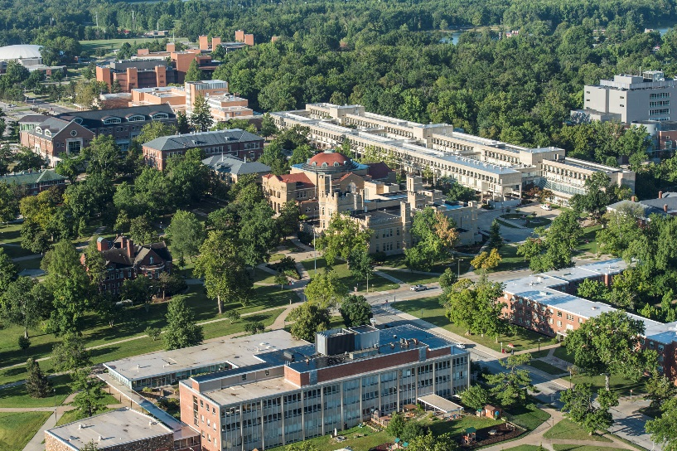




State of the System Address
Randy J. Dunn, President
October 2016

Slide 2

Welcome To The State Of The System 2016
State
of the
System Address
Randy J. Dunn
President
Greetings & Introductions
New Format Attempt
Some Additional Caveats
Q&A At Conclusion

Slide 3
The State Of Our System, In One Speech?
State
of the
System Address
Randy J. Dunn
President
Reaching … Not Recounting
Prioritizing … Not Prescribing
Strategic … Not Simplistic

Slide 4
Have We Progressed In 15 Years?
State
of the
System Address
Randy J. Dunn
President
“ [We] must not overlook the possibilities for maximizing the resources at our disposal … we need to find our niche and allocate resources accordingly. That means setting priorities. It means making tough decisions about which programs should be expanded and which should be eliminated or curtailed.”
- SIU President James E. Walker
September 20, 2001

Slide 5
Revisiting Last Year’s SOS Address
State
of the
System Address
Randy J. Dunn
President
The 3 Big Eras Of SIU (Establishment/Expansion/Retrenchment)
Elements Of Retrenchment (Disinvestment/Cost Shifts/Privatization/Tuition Control)
More Steps Or Tactics Than Strategy (Grow Enrollment/Grow Giving/Expand Revenue Base/Increase Shared Service)
Plus One Other Thing …

Slide 6
Simply More Tactics For 2016?
State
of the
System Address
Randy J. Dunn
President
Reduce Both The Number Of Administrators & “Administrative Overlap”
Increase Grass-Roots Political Advocacy
Close Revenue & Expense Gaps In “Outer-Ring” Programs
Program Review & Reprioritization

Slide 7
Of Course … It’s About Strategy
State
of the
System Address
Randy J. Dunn
President
“Retrenchment” Suggests Retreat
Tactics Only Buy Time
Reshaping Of The State-University Covenant
Affirmative & Transformational Approaches Needed … Strategic Responses Called For

Slide 8
State
of the
System Address
Randy J. Dunn
President

Slide 9
State
of the
System Address
Randy J. Dunn
President

Slide 10
What Defines A Strategic Response?
State
of the
System Address
Randy J. Dunn
President
Based On A Vision Of The External Environment
Looks At Organizational Structures, Resource Allocation, Human Talent, & New Technologies Of The Internal Environment
Components Must Relate Conceptually: The “Strategy Wheel”

Slide 11
State
of the
System Address
Randy J. Dunn
President
Students & Programs
Operations & Organization
Mission & Purpose
Identity & Reputation
Human Capital & Innovation

Slide 12
Mission & Purpose
State
of the
System Address
Randy J. Dunn
President
Build Institutional Distinctiveness
Decide Differentially
Watch (And Learn From) The Competition

Slide 13
Students & Programs
State
of the
System Address
Randy J. Dunn
President
Consider Unmet Market Segments
Identify Various Ways To “Reposition”
Center On The Student Relationship

Slide 14
Operations & Organization
State
of the
System Address
Randy J. Dunn
President
Innovate On Process & Function
Orient Decision Making Toward Action
Manage More Flexibly

Slide 15
Human Capital & Innovation
State
of the
System Address
Randy J. Dunn
President
Invest In Human Capital Needs
Identify Talent Pools
Innovate Around Growth & Emerging Program Markets
Exploit Available Technologies To Improve Organizational Communication

Slide 16
Identity & Reputation
State
of the
System Address
Randy J. Dunn
President
Strengthen The “One-Firm” SIU Brand
Emphasize Public Service Role
Reclaim And Re-Create Statewide Leadership Identity
Build Trust Every Time

Slide 17
SIU System Strategic Plan
State
of the
System Address
Randy J. Dunn
President
Actions And Initiatives That Respond To Strategic Components Identified
Utilizes A “Generative” Approach
Strategic Planning As Only One Type Of Planning

Slide 18
State
of the
System Address
Randy J. Dunn
President

Slide 19
Adapting To The New Strategic Realities
State
of the
System Address
Randy J. Dunn
President
Remove Status Quo & “Present Bias”
Higher Risks For Higher Rewards
Ability To Stay-The-Course On Interventions
Flatten Decision-Making
Living With Unpredictability & Turbulence
Never Having Enough Information

Slide 20
Tightly-Coupled Values
Student Accessibility With Affordability
Excellence In Teaching, Research, & Public Service
Embracing Diversity
Ethical Action & Integrity
Organizational Accountability Through Transparency
Distributed Leadership & Governance
Sustainable Practices
State
of the
System Address
Randy J. Dunn
President

Slide 21
Q & A
State
of the
System Address
Randy J. Dunn
President
???

Slide 22
State of the System Address
Randy J. Dunn, President
October 2016

